Slide 1


Concurrency

Slide 2

Homework
Store Inventory:
Implement a class to represent the store inventory using a concurrent data structure
The inventory should contain items (e.g., products) with initial quantities.
Restocking Mechanism:
Store must periodically restock items in the inventory, and adds a specified quantity of items to the inventory at regular intervals.
Purchase Functionality:
Implement a method for purchasing items from the store.
Ensure that purchasing is handled safely with concurrent access to the inventory using appropriate concurrent data structures or mechanisms.
Return true if purchase successful, false if not

Slide 3

Multitasking

Slide 4
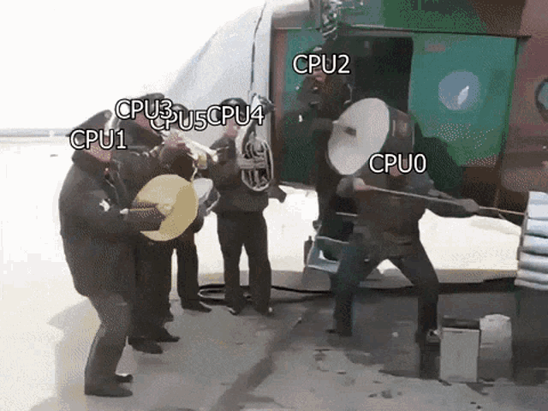
Multithreading

Slide 5
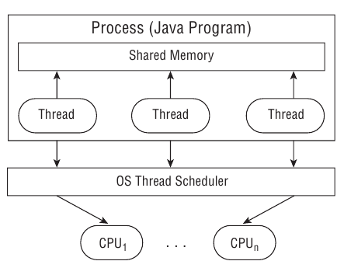
Process model

Slide 6
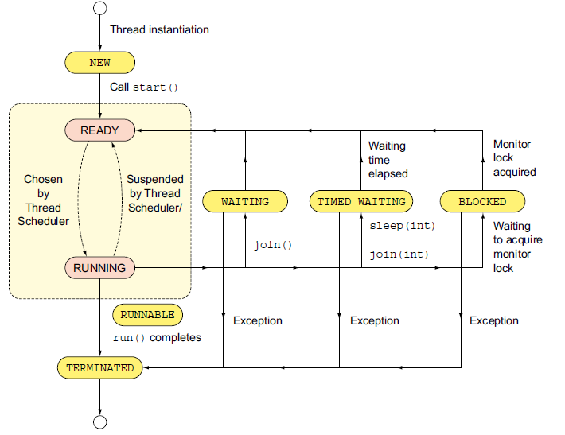
Thread lifecycle

Slide 7
Thread types
System - created by the JVM and runs in the background of the application (GC).
User-defined - one created by the application developer to accomplish a specific task.
Daemon - one that will not prevent the JVM from exiting when the program finishes. Both system and user-defined threads can be marked as daemon threads

Slide 8
Main Thread
public static void main(String args[]) { Thread thread = Thread.currentThread(); // ... }

Slide 9
Defining task
class Printer implements Runnable or extends Thread { @Override public void run() { for (int i = 0; i < 3; i++) { System.out.println("Printing record: " + i); } } }
class Main { public static void main(String[] args) { new Thread(new Printer()).start(); } }

Slide 10
What is the output?
class Printer implements Runnable { @Override public void run() { for (int i = 0; i < 3; i++) { System.out.println("Printing record: " + i); } } }
class Main { public static void main(String[] args) { new Thread(new Printer()).run(); new Thread(new Printer()).run(); new Thread(new Printer()).run(); } }

Slide 11
What is the output?
class Printer implements Runnable { @Override public void run() { for (int i = 0; i < 3; i++) { System.out.println("Printing record: " + i); } } }
class Main { public static void main(String[] args) { new Thread(new Printer()).start(); new Thread(new Printer()).start(); new Thread(new Printer()).start(); } }

Slide 12
Callable
Like a Runnable, but returns a value and can throw a checked exception
@FunctionalInterface public interface Callable<V> { V call() throws Exception; }

Slide 13
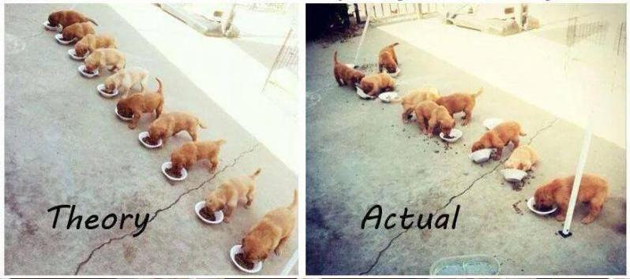

Pitfals

Slide 14
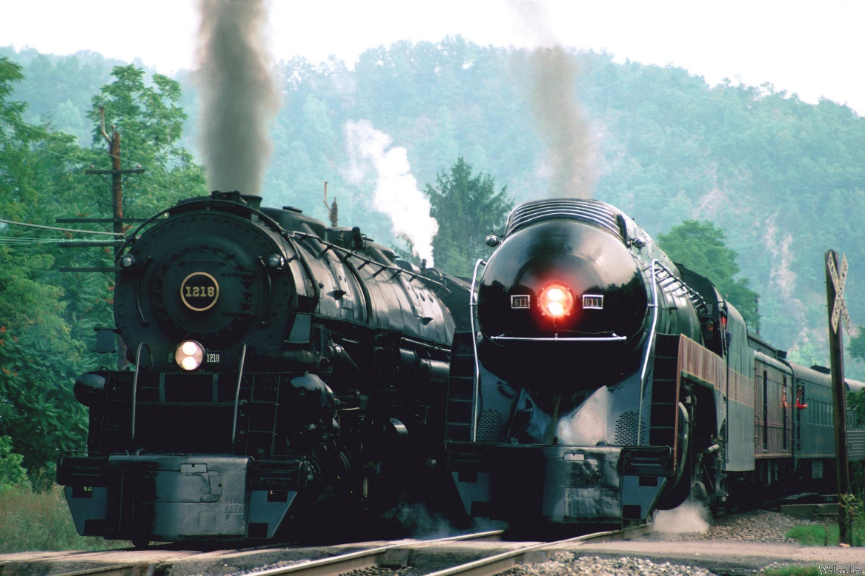


Race condition
var train1 = new TrainThread(); var train2 = new TrainThread(); train1.start(); train2.start();

Slide 15

DEADLOCK

Slide 16

LIVELOCK

Slide 17

Tools

Slide 18

Synchronization problem
Thread1
Thread2
Thread3
Monitor
Resource

Slide 19
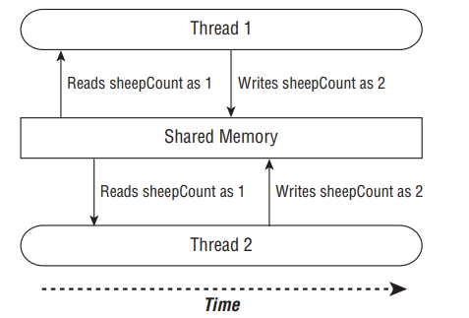
Synchronization problem

Slide 20
Synchronization problem
class PuppyManagerReport { private int count = 0; void increment() { this.count = count + 1;
System.out.print(count); } }
Thread 1 (increment) | Thread 2 (increment)
1: Retrieve c (0) | 2: Retrieve c (0)
3: 0 + 1 = 1 | 4: 0 + 1 = 1
5: Store result; c = 1 | 6: Store result; c = 1

Slide 21
Synchronization problem
class PuppyManagerReport { private int count = 0; synchronized void increment() { this.count = count + 1;
System.out.print(count); } }
Thread 1 (increment) | Thread 2 (increment)
1: Retrieve c (0)
2: 0 + 1 = 1
3: Store result; c = 1
 | 4: Retrieve c (1)
 | 5: 1 + 1 = 2
 | 6: Store result; c = 2

Slide 22
Synchronization problem. CPU Caching
class PuppyManagerReport { private volatile int count = 0; synchronized void increment() { this.count = count + 1;
System.out.print(count); } }

Slide 23
Synchronization problem. Slowness
class PuppyManagerReport { private volatile int count = 0; void increment() {
synchronized (this) {
this.count = count + 1; }
System.out.print(count); } }

Slide 24
Synchronization problem. REINVENTING WHEEL
class PuppyManagerReport { private final AtomicInteger count = new AtomicInteger(0); void increment() { this.count.incrementAndGet();
System.out.print(this.count); } }

Slide 25
java.util.concurrent
AtomicBoolean
AtomicInteger
AtomicLong
AtomicReference
…
CopyOnWriteArraySet
CopyOnWriteArrayList
ConcurrentMap
…

Slide 26
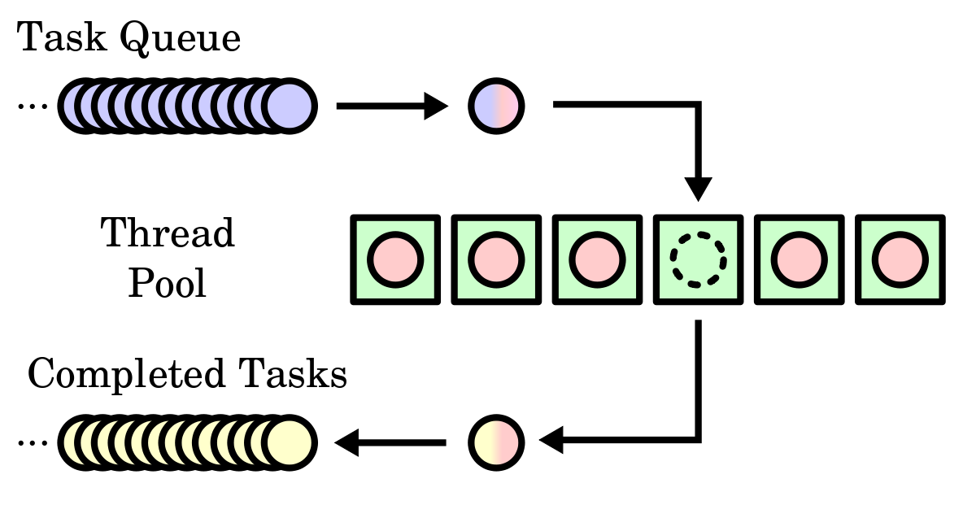
Thread pool

Slide 27
Thread pool
Group of pre-instantiated reusable threads that are available to perform a set of arbitrary tasks
Executors.newSingleThreadExecutor()
Executors.newSingleThreadScheduledExecutor()
Executors.newCachedThreadPool()
Executors.newFixedThreadPool(int threadsCount)
Executors.newScheduledThreadPool(int threadsCount)

Slide 28
ExecutorS. Result?
public static void main(String[] args) throws InterruptedException { final int workersCount = 20; final int animalsCount = 30; System.out.println("Collecting zoo inventory"); ExecutorService service = Executors.newFixedThreadPool(workersCount); try { PuppyManager manager = new PuppyManager(); for (int i = 0; i < animalsCount; i++) { service.submit(manager::incrementAndReport); } } finally { service.shutdown(); } System.out.println("Zoo inventory collected"); }

Slide 29
Executors
public static void main(String[] args) throws InterruptedException { final int workersCount = 20; final int animalsCount = 30; System.out.println("Collecting zoo inventory"); ExecutorService service = Executors.newFixedThreadPool(workersCount); try { PuppyManager manager = new PuppyManager(); for (int i = 0; i < animalsCount; i++) { service.submit(manager::incrementAndReport); } } finally { service.shutdown(); service.awaitTermination(10, TimeUnit.SECONDS); } System.out.println("Zoo inventory collected"); }

Slide 30
Submit vs Execute
void execute(Runnable command) // “fire-and-forget” Future<?> submit(Runnable task)

Slide 31

FUTURE - Waiting for Results
Future future = service.submit(() -> System.out.println("Hello Zoo"))
boolean isDone() boolean isCancelled() boolean cancel() V get() V get(long timeout, TimeUnit unit)

Slide 32
Scheduling Tasks
ScheduledExecutorService service = Executors.newSingleThreadScheduledExecutor();
schedule(Callable callable, long delay, TimeUnit unit)
schedule(Runnable command, long delay, TimeUnit unit)
scheduleAtFixedRate(Runnable command, long initialDelay, long period, TimeUnit unit)
scheduleAtFixedDelay(Runnable command, long initialDelay, long delay, TimeUnit unit)

Slide 33
Useful links
Concurrency by Baeldung
Concurrency by Oracle
Concurrency by HowToDoInJava

